Slide 1
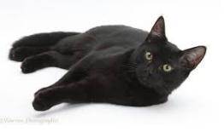
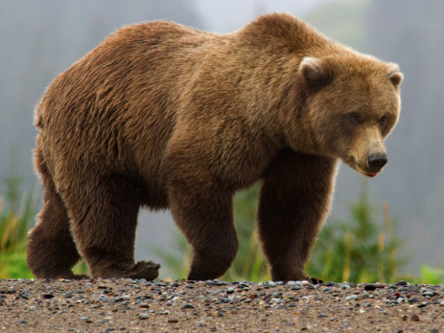
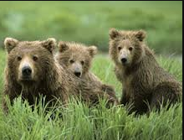
Land Animals
EnSquare
Unit 1: Section 1

Slide 2
Objectives:
Review: colours
Review : numbers, 1-10
Sentence structure:
I see a ___________
I see a _____ cat. (colour)
I see ____ bear. (1, 2 ,3 )
2,3 cats
2, 3, bears
Phonics:
The initial sounds of ‘b’, ‘c’ and the ending
sound of ‘t’ .

Slide 3
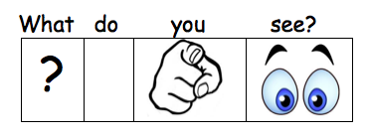
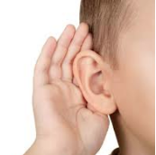
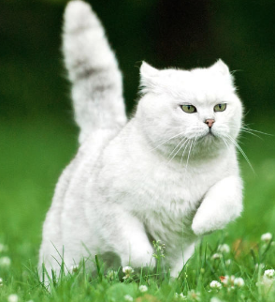
Listen and Repeat
I see a cat.
I see a bear.

Slide 4
Listen and Repeat
I see a __________.
I see a __________.
bear
cat

Slide 5
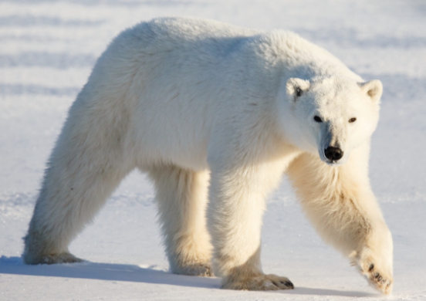
I see a __________.
I see a __________.
cat bear

Slide 6
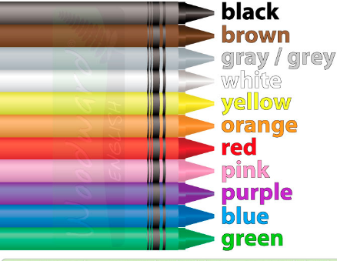

Slide 7
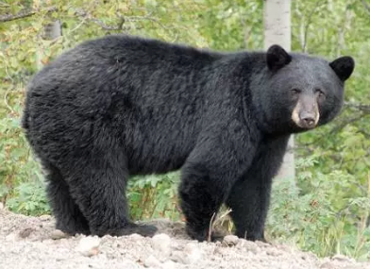
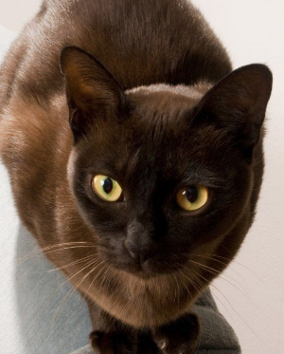
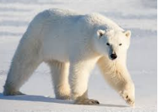
I see a black bear.
I see a white cat.
I see a brown bear.
I see a brown cat.
I see a white bear.

Slide 8
I see a _______ ________
1 2 3 4 5

Slide 9
The name of this letter is ____. The sound ♪ of this letter is ____.
The name of this letter is ____. The sound ♪ of this letter is ____.
b b b
B b
C c
The name of this letter is ____. The sound ♪ of this letter is ____.
c c c
T t
The name of this letter is ____. The sound ♪ of this letter is ____.
t t t

Slide 10
The name of this letter is ____. The sound ♪ of this letter is ____.
b b b bear
c c c cat

Slide 11
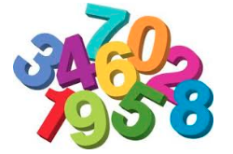
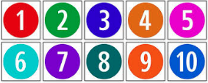
Listen and Repeat

Slide 12
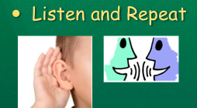
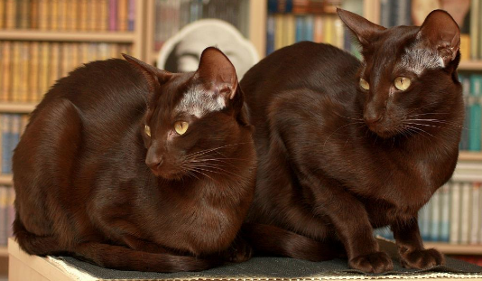
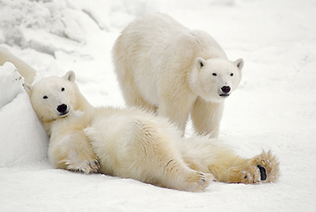
I see 1 cat.
I see 2 cats.
I see 1 bear .
I see 2 bears.
I see 3 bears.

Slide 13
I see _____bears.
I see ____ cat.
I see _____ cats.
I see _____ bears.

Slide 14
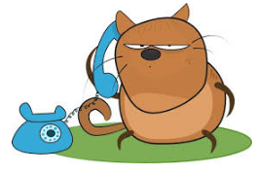
do I live?

Slide 15
Wrap-up
I see ____ cat.
I see ____ bears.
I see a ______ cat.

Slide 16
HOMEWORK: Watch the Video
Brown Bear

